Slide 1
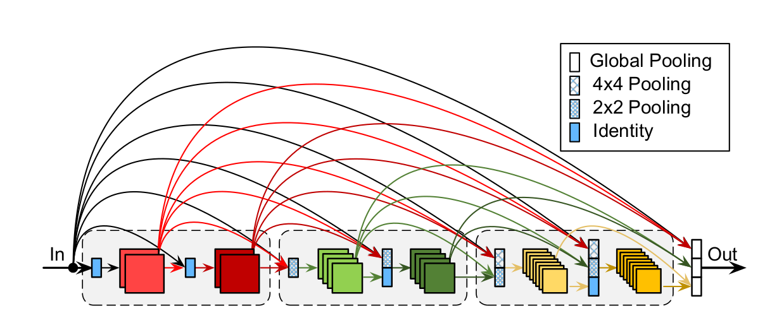
CondenseNet
PAGE: 01

Slide 2
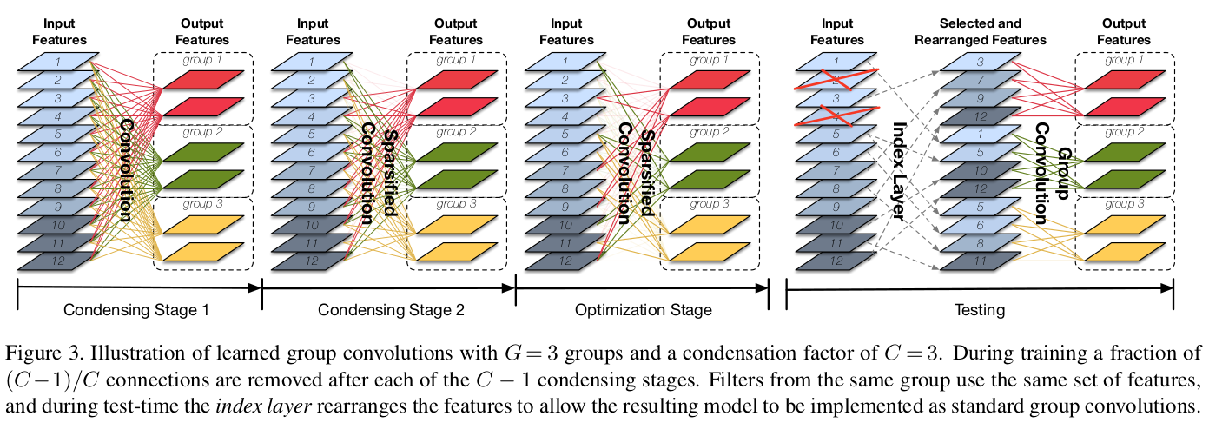
Learned Group Convolution
PAGE: 01

Slide 3
Advantage of CondenseNet
Compared to DenseNets, CondenseNets use only 1/10 of the computation
at comparable accuracy levels
can be efficiently deployed on devices with limited computational power such as cars
PAGE: 01

Slide 4
Recognition Performance
Model | Validation Accuracy | Test Accuray | Training Time
DenseNet | 0.9458 | 0.9346 | 20min
DenseNet + Data Augmentatjion | 0.9982 | 0.9313 | 2h20min
PAGE: 01

